Slide 1
DEPARTMENT OF THE PROSECUTING ATTORNEY
Independent Investigation
Arrest of Tevita Cadiente
University Avenue between Varsity Place and Dole Street
Honolulu, HI
January 1, 2024

Slide 2
Investigative Questions
Question 1: Was the use of force used on Tevita Cadiente on January 1, 2024 justified?
Question 2: Will any charges be filed against any of the Honolulu Police Officers involved in the arrest of Tevita Cadiente on January 1, 2024?

Slide 3
Conclusion
The use of force on Tevita Cadiente on January 1, 2024 was justified.
No charges will be brought against the Honolulu Police Officers involved in the arrest of Tevita Cadiente on January 1, 2024.

Slide 4
The Law

Slide 5
Hawaiʻi Revised Statutes
HRS Sec. 803-4 On suspicion. Whenever a crime is committed, and the offenders are unknown, and any person is found near the place where the crime was committed, either endeavoring to conceal oneself, or endeavoring to escape, or under such other circumstances as to justify a reasonable suspicion of the person being the offender, the person may be arrested without warrant.

Slide 6
Caselaw
Under Hawaiʻi law, (State v. Melear, 63 Haw 488 (1981)), an officer may lawfully detain a person based on reasonable suspicion. Reasonable suspicion requires “specific articulable facts in which, taken together with rational inferences from those facts, reasonably warrant that intrusion.” “Neither the Fourth Amendment nor the Hawaiʻi Constitution require a policeman who lacks the precise level of information necessary for probable cause to arrest to simply shrug his shoulders and allow a crime to occur or a criminal to escape.” State v. Kaleohano, 99 Haw 370, 380 (2002).

Slide 7
Here the Officers knew Tafokitau had just driven up University Avenue, that shots were fired and an officer was hit, the radio said “heʻs running,” and it appeared that a person matching Tafokitauʻs description (tall polynesian male with facial hair and distinctly patterned shorts) was trying to escape from a location where a crime was committed (shots fired at an officer who was hit) justified a reasonable suspicion that Cadiente was the offender justifying his arrest without a warrant.

Slide 8
Hawaiʻi Revised Statutes
HRS Sec. 803-5 By police officer without warrant. (a) A police officer or other officer of justice, may, without warrant, arrest and detain for examination any person when the officer has probable cause to believe that such person has committed any offense, whether in the officerʻs presence or otherwise.
(b) For purposes of this section, a police officer has probable cause to make an arrest when the facts and circumstances within the officerʻs knowledge and of which the offficer has reasonable trustworthy information are sufficient in themselves to warrant a person of reasonable caution in the belief that a crime has been or is being committed.

Slide 9
Here the officers knew that Tafokitau had just driven up University Avenue, that shots were fired and an officer was hit, the radio said “heʻs running” and it appeared that a person matching Tafokitauʻs description (tall polynesian male with facial hair and distinctly patterned shorts) was trying to escape from a location where a crime was committed, the officers had probable cause to arrest Cadiente.

Slide 10
In Hill v. California, 401 U.S. 797 (1971), the U.S. Supreme Court upheld the validity of an arrest despite mistaken identity because the officers had a reasonable, good-faith belief that the arrestee was their suspect. “The upshot was that the officers in good faith believed Miller was Hill and arrested him. They were quite wrong as it turned out, and subjective good-faith belief would not in itself justify either the arrest or the subsequent search. But sufficient probability, not certainty, is the touchstone of reasonableness under the Fourth Amendment and on the record before us the officers’ mistake was understandable and the arrest a reasonable response to the situation facing them at the time.” Id. at 804-04.

Slide 11
Hawaiʻi Revised Statutes
HRS Sec. 803-7: Use of force; duty to intervene and report unnecessary or excessive force.
(a) “In all cases where the person arrested refuses to submit or attempts to escape, a degree of force may be used by a law enforcement officer as is necessary to compel the person to submission.”

Slide 12
In this case, the responding Honolulu Police Officers believed that Tevita Cadiente was in fact Sidney Tafokitau. The officers knew that Tafokitau had just driven up University Avenue, and Cadiente was running down University Avenue away from where shots were fired and an officer was hit. The radio said “he’s running.” Both Tafokitau and Cadiente are tall Polynesian males with facial hair and were wearing similarly patterned shorts.
As a result, the officers attempted to arrest Tevita Cadiente.
Cadiente resisted their efforts to arrest him.
The officers then used such force “as necessary to compel the person to submission.”

Slide 13
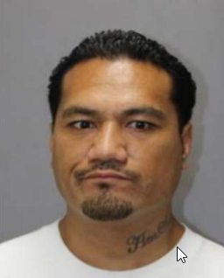
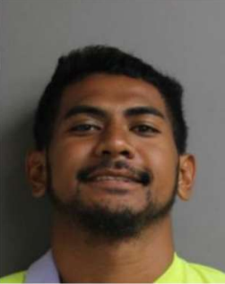

Slide 14
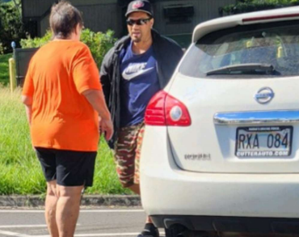
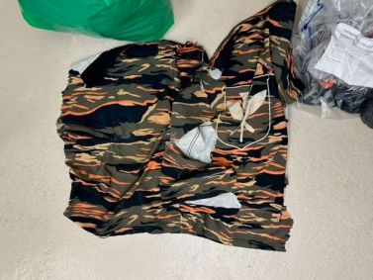
Sidney Tafokitau’s shorts on 1/1/2024 Tevita Cadiente’s shorts on 1/1/2024

Slide 15
Hawaiʻi Revised Statutes
HRS Sec. 703-307: Use of force in law enforcement states: (1) “Subject to the provisions of this section and of section 703-310, the use of force upon or towards the person of another is justifiable when the actor is making or assisting in making an arrest and the actor believes that such force is immediately necessary to effect a lawful arrest.”

Slide 16
The officers’ use of force on Tevita Cadiente was justifiable if the officers believed that such force was immediately necessary to effect the arrest.
Cadiente, in spite of repeated commands to put his hands behind his back to be handcuffed, kept struggling and refused to do so. He kept reaching for his waist area, a known location for hiding weapons and his arms kept flailing about, raising concerns he was reaching for a weapon on the ground or in an officer’s possession.

Slide 17
The officers made repeated physical attempts to handcuff Cadiente including trying to move his arms, and using their hands and feet on him to gain compliance.
This included an officer putting all of his weight on Cadiente’s shoulder without success. After even that failed, an officer can be heard yelling at Cadiente to put his hands behind his back to be handcuffed.
Eventually the officers succeeded in handcuffing Cadiente and placing him under arrest.

Slide 18
Hawaiʻi Revised Statutes
HRS Sec. 703-307 Use of force in law enforcement
(2) The use of force is not justifiable under this section unless:
(a) The actor makes known the purpose of the arrest or believes that it is otherwise known by or cannot reasonably be made known to the person to be arrested

Slide 19
Here the officers knew shots were fired, that an officer was hit, the radio said “heʻs running.” Cadiente, like Tafokitau was a tall polynesian male with facial hair and the exigencies of the situation were such that either the suspect knew what the arrest was for and there was no time to explain the arrest before attempting to take him into custody.

Slide 20
HPD Use of Force Policies

Slide 21
HPD Use of Force Policy No. 1.04 (2021)
HPD officers are allowed to use reasonable force. It must be “objectively reasonable” in light of the facts and circumstances as the officer perceived them to be at the time of the incident.
In this case, the responding officers believed that Tevita Cadiente was in fact Sidney Tafokitau.

Slide 22
They knew that Sidney Tafokitau had tried to kill his ex-girlfriend that morning by shooting her three times with his AR-15, had been shooting at police officers all day and had just shot and hit a police officer further up University Avenue.
Were the officers’ Use of Force then “objectively reasonable?”

Slide 23
HPD Use of Force Policy No. 1.04 (2021)
In determining the reasonableness of the officers’ actions, the First factor to be considered is the Severity of the Crime committed by the suspect.
Here that would be Attempted Murder in the First Degree. (HRS 707-701 attempting to cause the death of a law enforcement officer arising out of the performance of official duties.). The more serious the offense, the greater the justification for the use of force.
In this case, Tafokitau had shot his ex-girlfriend, had been shooting at police officers with his AR-15 all day, and had just shot and hit an officer further up University Avenue.

Slide 24
HPD Use of Force Policy No. 1.04 (2021)
The Second factor regarding the reasonableness of the use of force is the Level of Threat. Here Cadiente was reaching for his waist area and Officer 4, based on his training and experience, thought he might have a weapon there. Officer 5 thought there might be a weapon nearby (Cadiente had something in his right hand as he was fleeing. It turned out to be a cell phone.). Officer 2 was concerned that Cadiente was near Officer 2’s firearm when he was trying to subdue him.

Slide 25
HPD Use of Force Policy No. 1.04 (2021)
The Third factor regarding Reasonable Force is the subject’s Level of Resistance. The greater the level or behavior of resistance, the greater the justification for greater use of force. Here it was Active Resistance when the subject physically counteracts an officer’s attempt to control the situation that creates a risk of bodily injury to the officers.
Cadiente kept resisting multiple officers’ attempts to handcuff and arrest him. He refused to put his hands behind his back and kept reaching for his waist area and flailing his arms around; raising concerns he was reaching for a weapon he had on his person or was nearby including on the ground or in an officers’ possession.

Slide 26
HPD Use of Force Policy No. 1.04 (2021)
The type of Control Force Options for officers to use when effecting an arrest include physical confrontation consisting of “strikes, kicks, takedowns, strong grabs . . . . wrestling and other active physical measures to control a resistant or violent person.” Also referred to as “Empty Hand Techniques.”
[The United States Department of Justice uses the description “Empty Hand Control” as a Hard Technique: officers using punching and kicking to restrain an individual.]
Here, the Honolulu Police Officers used all of the above physical techniques (though not kicking) and eventually were able to handcuff and arrest Mr. Cadiente.

Slide 27
HPD Use of Force Policy No. 1.04 (2021)
Regarding the use of strikes or kicks, “the main goal is to cause a muscle dysfunction or to provide a distraction for the officer to gain control. Primary targets are large muscle mass areas, and secondary targets are joints and bones. Targeting of deadly force areas (e.g. the eyes, groin, throat, and heart) must be restricted to only a small number of appropriate and justified situations.”
Here an officer stepped hard on Cadiente’s shoulder twice. The officers used multiple fist strikes in attempting to handcuff Cadiente.

Slide 28
The Scene

Slide 29
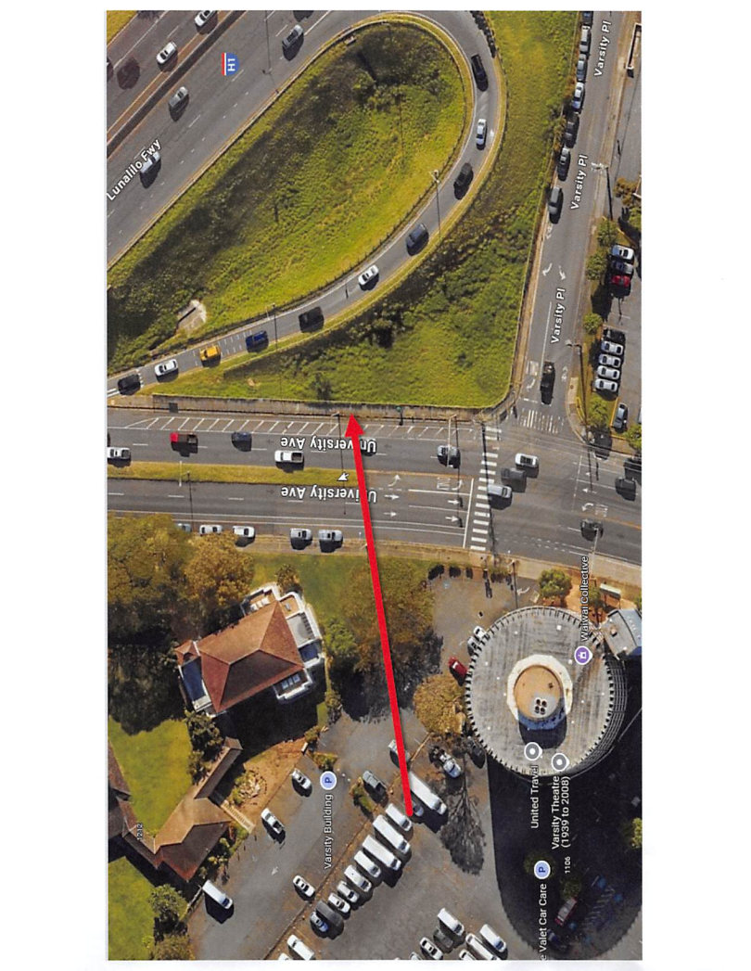

Slide 30
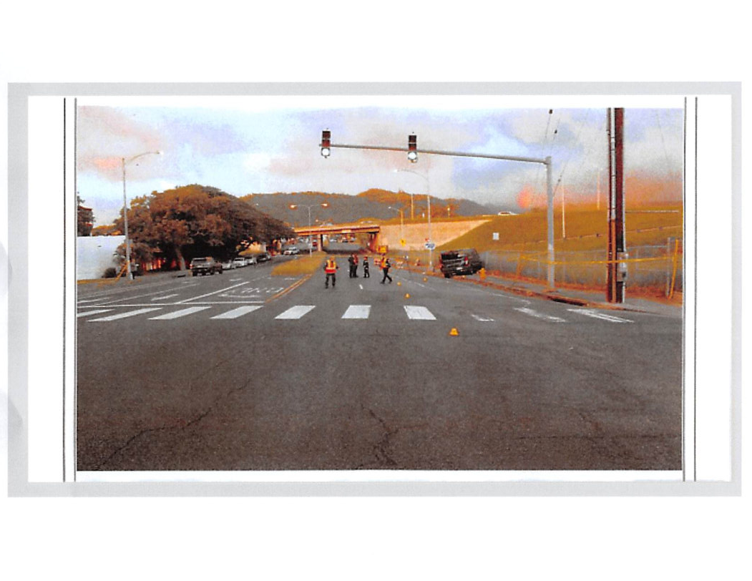

Slide 31
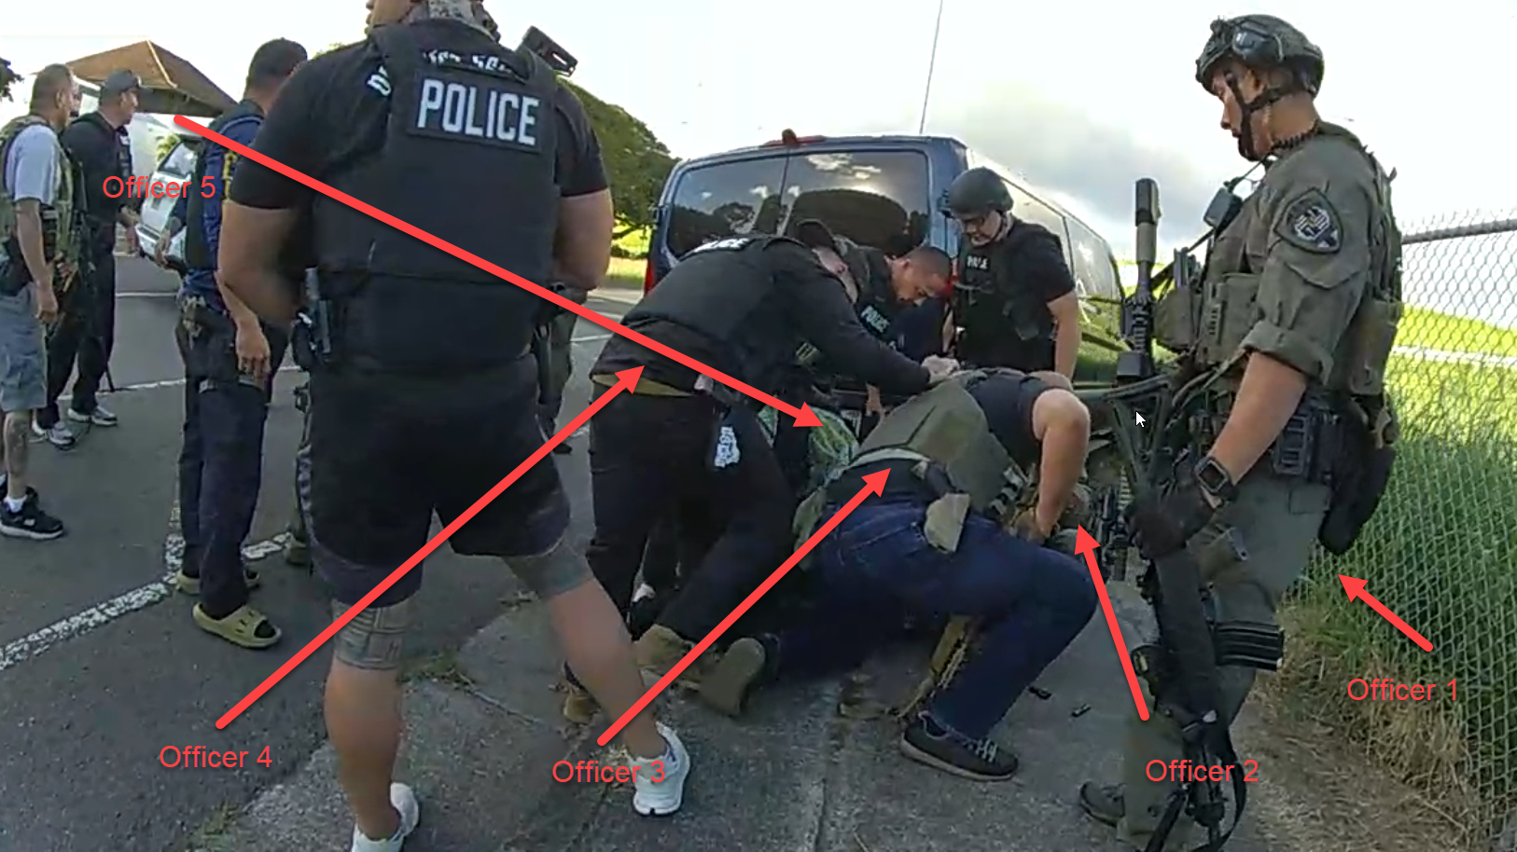

Slide 32
Honolulu Police Officer Actions
At about 4:14 p.m., Officer 6 was driving on Kapiolani Boulevard in an unmarked car with Officer 7 as his passenger. They heard from dispatch that shots were fired and an officer was down. Through the radio, he heard gunshots and a male yelling. Officer 6 then turned up University Avenue. Hearing “heʻs running” on the radio, Officers 6 and 7 saw Cadiente running Mauka up University Avenue. Believing that Cadiente was Tafokitau, Officer 6 pulled his vehicle up next to him. Officer 7 leaned out the passenger window and announced to Cadiente “stop, police” several times. Officer 7 then got out of the car. Officer 7 was wearing a vest with a badge and POLICE on the front. Cadiente looked at them said “Oh fuck,” turned around and started running down in the Makai direction on University Avenue.

Slide 33
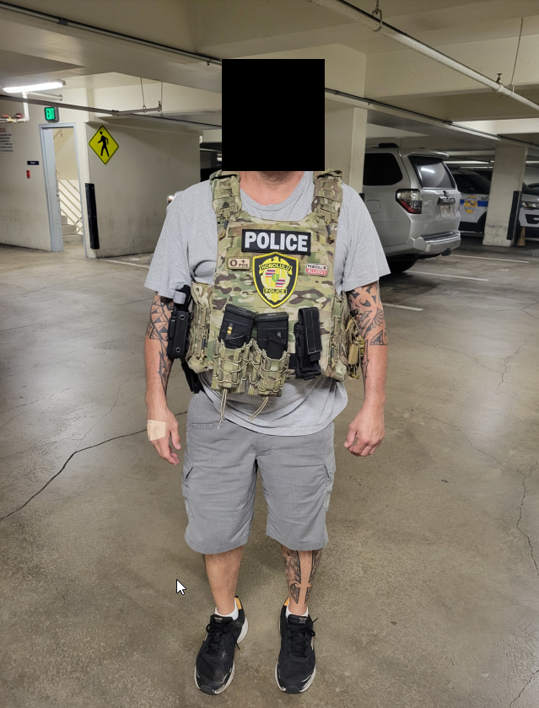

Slide 34
Honolulu Police Officer Actions
Officer 1 saw that Cadiente was fleeing from a Honolulu Police Officer, running South or Makai bound on University Avenue. Based on his location, appearance and clothing, Officer 1 thought Cadiente was Sidney Tafokitau.
Officer 1 drove his HPD SWAT van onto the sidewalk in an attempt to block Cadienteʻs escape.
The van bumped over the curb and inadvertently collided with Cadiente, pushing him against a chain link fence.
Officer 1 announced “Police” multiple times and pulled Cadiente to the ground in a prone position as Cadiente was trying to pull away from him. Cadiente kept reaching under the van for a dark object which Officer 1 was concerned might be a firearm.

Slide 35
Honolulu Police Officer Actions
Officer 2 was a passenger in the HPD SWAT van. He too thought that Cadiente was Tafokitau.
He attempted to place Cadiente in handcuffs. Cadiente was on his stomach and kept reaching for his own waist area.
Officer 2 struck him twice to the torso with his fist without success. Cadiente grabbed Officer 2ʻs left foot and would not let go.
Eventually, Officer 2 was able to handcuff Cadiente.

Slide 36
Honolulu Police Officer Actions
Officer 3 assisted in trying to control and arrest Cadiente. Cadiente was fighting and struggling and trying to break free. Cadiente got up on an elbow and was trying to stand up. Officer 2 was trying to hold him down. Officer 3 saw a number of dark colored objects on the ground near Cadiente and was concerned they were weapons.
Officer 3, thinking it was Sidney Tafokitau, was concerned that Tafokitau had shot his ex-girlfriend earlier in the day, shot at least one police officer, and was wanted on multiple warrants for Attempted Murder. He yelled loud commands “POLICE! GET ON THE GROUND! GET ON THE GROUND!” Cadiente refused to comply. Officer 3 tried unsuccessfully to leg sweep Cadiente’s left arm. He then shoved Cadiente’s upper back with his foot to keep him from standing. Cadiente continued to resist and fight despite other officers yelling for him to stop resisting and place his hands behind his back (to be handcuffed).

Slide 37
Honolulu Police Officer Actions
Officer 4 assisted other officers in trying to handcuff and arrest Cadiente who he believed was Tafokitau. Cadiente continued to resist and placed his hands under his body near his waist. Through training and experience, Officer 4 knew that the waist area is a common location for suspects to conceal weapons. Given Cadiente’s continued efforts to resist getting handcuffed, Officer 4 hit Cadiente in his right shoulder area 3 times with his fist. He then yelled “STOP RESISTING!” Then Officer 4 used his right foot and put his full body weight on Cadiente’s right shoulder. Eventually Officer 2 was able to handcuff Cadiente. Throughout the incident Officer 4 gave Cadiente verbal commands to stop resisting without success until he was eventually handcuffed.

Slide 38
Honolulu Police Officer Actions
Officer 5 ran to the van to assist in arresting who he thought was Sidney Tafokitau. Officer 5 announced he was “Police” and ordered him to place his hands behind his back.
Cadiente was yelling and resisting, continuing to pull his hands under his chest preventing the officers from handcuffing him. Officer 5 delivered several distracting strikes to Cadiente’s torso with his fist and pulled on his left arm to enable handcuffing. Eventually they were able to handcuff him.

Slide 39
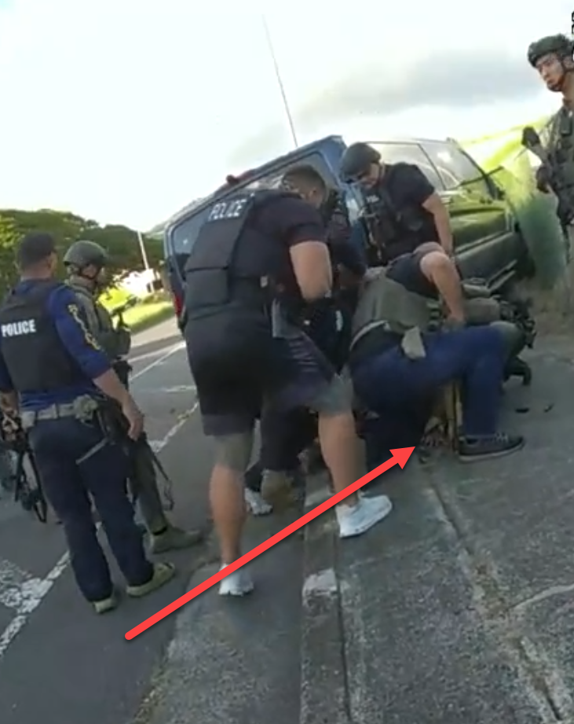

Slide 40
Cadiente’s Statements
He knew Sidney Tafokitau from the clubs.
He knew Sidney Tafokitau was being chased and ran out to record it.
Cadiente admitted to having Tafokitau’s name and number in his cell phone, (listed as Nuketown). He admitted to calling Tafokitau twice that day but he did not answer.
He thought the first officer who pulled up beside him and got out with a gun and was yelling at him was “Pepe’s boy with a gun.” Cadiente knew Tafokitau as “Pepe.”
He said he didnʻt know the first person who got out of the car was a police officer (Officer 7).

Slide 42
Hawaiʻi Revised Statutes
HRS Sec. 803-7: Use of force; duty to intervene and report unnecessary or excessive force.
(a) “In all cases where the person arrested refuses to submit or attempts to escape, a degree of force may be used by a law enforcement officer as is necessary to compel the person to submission.”

Slide 43
Hawaiʻi Revised Statutes
HRS Sec. 703-307: (1) Use of force in law enforcement states: “Subject to the provisions of this section and of section 703-310, the use of force upon or towards the person of another is justifiable when the actor is making or assisting in making an arrest and the actor believes that such force is immediately necessary to effect a lawful arrest.”

Slide 44
Analysis
Based on the statutes, the caselaw, and HPD Use of Force Policies, the HPD Officers’ use of force was reasonable.
Whether that force was objectively reasonable is determined in light of the facts and circumstances as the officers perceived them to be at the time of the incident.
Here the officers mistakenly thought that Cadiente was Tafokitau, however, based on the specific articulable facts and the circumstances, the officers had reasonable suspicion to detain and arrest and probable cause to arrest him.
Cadiente refused to submit to the arrest and fought violently with the officers. The officers used that degree of force as was necessary to compel Cadiente to submission.

Slide 45
Conclusion
The use of force on Tevita Cadiente on January 1, 2024 was justified.
No charges will be brought against the Honolulu Police Officers involved in the arrest of Tevita Cadiente on January 1, 2024.

Slide 46
DEPARTMENT OF THE PROSECUTING ATTORNEY
Independent Investigation
Arrest of Tevita Cadiente
University Avenue between Varsity Place and Dole Street
Honolulu, HI
January 1, 2024

